Slide 1

Group Members
Effects of pseudorandom and quantum-random number generators in soft computing
1.Shubham Garg : 9919103057
2.Manas Dalakoti : 9919103037
3.Gaurav Kumar : 9919103119

Slide 2
Problem Statement
The problem statement of the paper is to investigate and compare the effects of two types of random number generators, pseudorandom and quantum-random number generators, on the performance of soft computing algorithms.
The study aims to determine which type of random number generator is more effective in improving the performance of soft computing algorithms, and under what circumstances. The paper highlights the importance of this problem because the choice of random number generator can significantly impact the performance of soft computing algorithms, especially when dealing with complex problems or when a high degree of randomness is required.

Slide 3
General Introduction
Quantum and classical hypotheses of our reality are individually definitive and yet are independently paradoxical, in that they are both scientifically verified though contradictory to one another. These concurrently antithetical, nevertheless infallible natures of the two models have enflamed debate between researchers since the days of Albert Einstein and Erwin Schrödinger during the early twentieth century.
Though the lack of a Standard Model of the Universe continues to provide a problem for physicists, the field of Computer Science thrives by making use of both in classical and quantum computing paradigms since they are independently observable in nature.
Though the vast majority of computers available are classical, quantum computing has been emerging since the late twentieth century and is becoming more and more available for use by researchers and private institutions.
Through this process, computational complexity has been reduced by a factor of n. Bounded-error quantum polynomial time (BQP) problems are a set of computational problems which cannot be solved by a classical computer in polynomial time, whereas a quantum processor has the ability with its different laws of physics.

Slide 4
Significance and Novelty
The research paper is significant and novel for several reasons:
The paper addresses an important issue in soft computing by investigating the impact of different types of random number generators on the performance of soft computing algorithms.
The study compares the performance of three different soft computing algorithms, including evolutionary algorithms, artificial neural networks, and fuzzy systems, using both pseudorandom and quantum-random number generators.
The paper specifically focuses on the comparison between pseudorandom and quantum-random number generators. While pseudorandom generators are widely used in soft computing, the study highlights the potential benefits of using quantum-random generators, which generate truly random numbers and may be more suitable for complex problems.
Overall, the research paper is significant and novel because it provides valuable insights into the impact of random number generators on the performance of soft computing algorithms, and it provides recommendations for selecting the appropriate generator based on the specific requirements of the problem.

Slide 5
Solution Approach:
The solution approach of the paper involves conducting an empirical study to compare the performance of soft computing algorithms using different types of random number generators. The study involves testing three different soft computing algorithms, namely evolutionary algorithms, artificial neural networks, and fuzzy systems, on a range of benchmark problems.
For each algorithm and problem, the study compares the performance using two different types of random number generators, a pseudorandom number generator and a quantum-random number generator.
The study evaluates the performance of each algorithm by measuring its ability to find optimal or near-optimal solutions and its convergence speed.To ensure the validity of the study, the authors use appropriate statistical techniques to analyze the results, including t-tests, ANOVA tests, and graphical representations of the performance measures.
The study provides valuable insights into the best practices for selecting the appropriate generator based on the specific requirements of the problem.

Slide 6
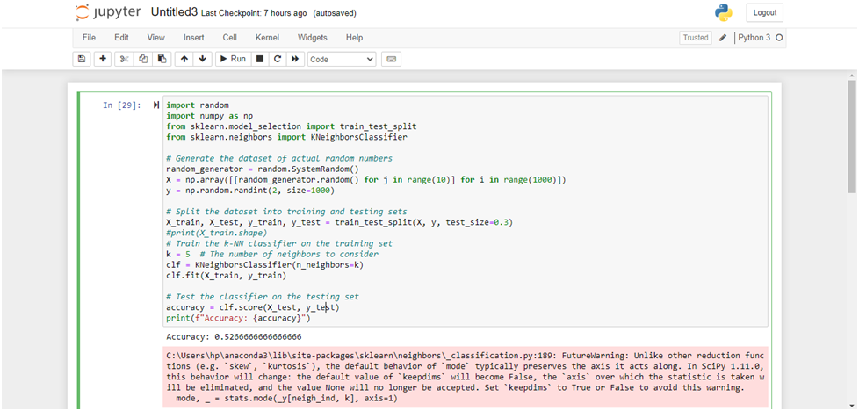
Implementation Details
Effect of random numbers in KNN Classification Algorithm

Slide 7
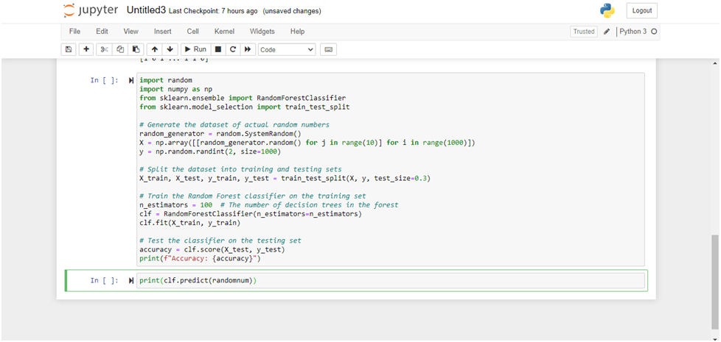
Effect of random numbers in Decision Tress Classification Algorithm

Slide 8
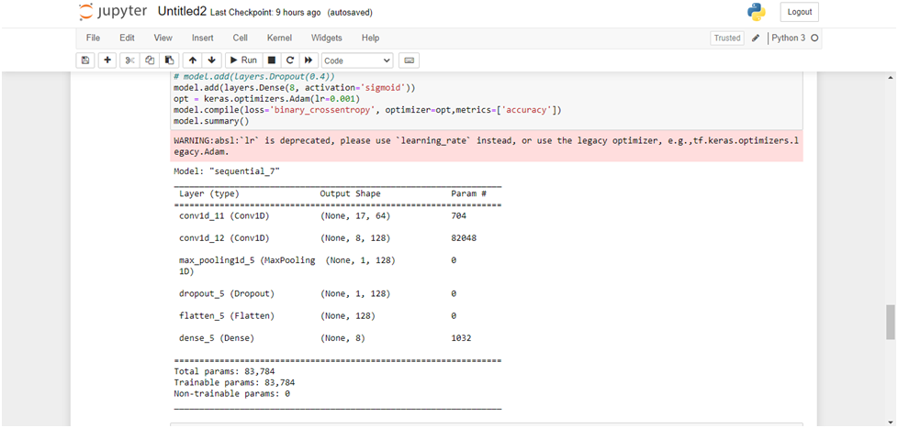
Effect of random numbers in CNN Model

Slide 9


